Slide 1


GNU & Unix commands
Exam 101
Linagora Formation
<formation@linagora.com>

Slide 2
Summary
Subject 103 – GNU & Unix commands 113
Working from the command line 114
Text-stream processing with filters 141
Basic File Management 176
Using streams, pipes and redirects 226
Creation, control and interruption of process 244
Changing process priorities 264
Search in text files with regular expressions 268
Text file editing with vi 287
LPIC-1 – Examen 101
<numéro> / 395

Slide 3
Summary
Subject 103 – GNU & Unix commands 113
Working from the command line 114
Text-stream processing with filters 141
Basic File Management 176
Using streams, pipes and redirects 226
Creation, control and interruption of process 244
Changing process priorities 264
Search in text files with regular expressions 268
Text file editing with vi 287
LPIC-1 – Examen 101
<numéro> / 395

Slide 4
The command cat
Means: catenate.
Displays the arguments in text files after each other:
$ cat toto tata titi
[...]
http://fr.wikipedia.org/wiki/Cat_(Unix)
LPIC-1 – Examen 101
<numéro> / 395

Slide 5
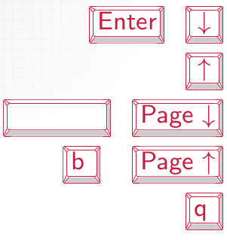
The command less
The command less allows to display the content of the text files passed as arguments by controlling their scroll:
$ less toto.txt
To control the scroll:
scroll down one line
scroll up one line
scroll down one page
scroll up one page
quit
http://www.gnu.org/software/less/ http://www.greenwoodsoftware.com/less/ http://fr.wikipedia.org/wiki/Less_(Unix)
LPIC-1 – Examen 101
<numéro> / 395

Slide 6
The command nl
Displays each line of the text file preceded argument of his number: :
$ nl toto
  first line
  second line
  third line
  fourth line
  fifth line
http://fr.wikipedia.org/wiki/Nl_(Unix)
LPIC-1 – Examen 101
<numéro> / 395

Slide 7
The command pr
Displays text files arguments in a form to be printed (page of 66 lines including 5 header lines and footer of five blank lines):
$ cat toto coucou
$ pr toto
2011-12-27 16:33
toto
Page 1
hello
[...]
http://en.wikipedia.org/wiki/Pr_(Unix)
LPIC-1 – Examen 101
<numéro> / 395

Slide 8
The command od
Principle
Means: octal dump.
Displays the contents of a file in octal two bytes by two bytes:
$ cat toto hello
$ od toto
0000000 067543 061565 072557 000012
0000007
http://fr.wikipedia.org/wiki/Od_(UNIX)
LPIC-1 – Examen 101
<numéro> / 395

Slide 9
The command od
Options
The option -b displays the file content in octal two bytes by two bytes
$ od -b toto
0000000 143 157 165 143 157 165 012
0000007
The option -c displays the content of the file character by character:
$ od -c toto
0000000 c o u c o u \n 0000007
The option -x displays the file contents in hexadecimal two bytes by two bytes.:
$ od -x toto
0000000 6f63 6375 756f 000a
0000007
LPIC-1 – Examen 101
<numéro> / 395

Slide 10
The command head
Displays the first 10 lines of each of the arguments in text files:
$ head toto tata titi
==> toto <==
[10 first lines of the file toto]
==> tata <==
[10 first lines of the file tata]
==> titi <==
[10 first lines of the file titi]
The option -n indicates the number of rows to display:
$ head -n 5 toto
[5 first lines of the file toto]
http://fr.wikipedia.org/wiki/Head_(Unix)
LPIC-1 – Examen 101
<numéro> / 395

Slide 11
The command tail
Displays the last 10 lines of each of the text files as arguments:
$ tail toto tata titi
==> toto <==
[10 first lines of the file toto]
==> tata <==
[10 first lines of the file tata]
==> titi <==
[10 first lines of the file titi]
The option -n indicates the number of lines to display:
$ tail -n 5 toto
[5 first lines of the file toto]
http://fr.wikipedia.org/wiki/Tail_(Unix)
LPIC-1 – Examen 101
<numéro> / 395

Slide 12
The command tail
Option -f
The option -f of the command tail :
  displays the last lines of the file argument;
  does not make the hand;
  displayes incrementally the added lines at the end of the file.
Is mainly used to monitor log files:
# tail -f /var/log/messages
LPIC-1 – Examen 101
<numéro> / 395

Slide 13
The command uniq
Displays the contents of the text file as an argument in displaying once the same lines that follow:
$ cat toto glub
glub glub glop glop glub glub
$ uniq toto glub
glop glub
The command uniq is often used following the command sort in a sequence with pipes to eliminate duplicates after sorting.
http://fr.wikipedia.org/wiki/Uniq
LPIC-1 – Examen 101
<numéro> / 395

Slide 14
The command cut
Extract parts of the lines of text files arguments.
The option -d (delimiter ) indicates the character that defines the fields.
The option -f (fields ) indicates the fields to extract.
Example:
$ cat toto a1:a2:a3:a4:a5:a6:a7:a8:a9:a10 b1:b2:b3:b4:b5:b6:b7:b8:b9:b10 c1:c2:c3:c4:c5:c6:c7:c8:c9:c10
$ cut -d : -f 2,4,5-8 toto a2:a4:a5:a6:a7:a8 b2:b4:b5:b6:b7:b8 c2:c4:c5:c6:c7:c8
http://en.wikipedia.org/wiki/Cut_(Unix)
LPIC-1 – Examen 101
<numéro> / 395

Slide 15
The command sort
Principle
Sort lines of text files arguments, supposedly organized in columns.
Without option, the sort order is lexicographical order of the first column of each line, the columns are delimited by spaces:
$ cat toto cc bb
bb aa aa zz
$ sort toto aa zz
bb aa cc bb
http://en.wikipedia.org/wiki/Sort_(Unix)
LPIC-1 – Examen 101
<numéro> / 395

Slide 16
The command sort
Options
The option -k (key ) sort relative to another column:
$ sort -k 2 toto bb aa
cc bb aa zz
LPIC-1 – Examen 101
<numéro> / 395

Slide 17
The command sort
Options
The lexicographical order places capital letters before lowercase letters:
$ cat toto zz
MM BB
aa
$ sort toto BB
MM
aa zz
The option -f ignores this distinction:
$ sort -f toto aa
BB MM
zz
LPIC-1 – Examen 101
<numéro> / 395

Slide 18
The command sort
Options
The lexicographical order does not sort numbers as we might expect:
$ cat toto 51
1664
33
$ sort toto 1664
33
51
The option -n (numeric ) indicates the sirt should be done in numerical order:
$ sort -n toto 33
51
1664
LPIC-1 – Examen 101
<numéro> / 395

Slide 19
The command sort
Options
The option -t specifies the character to use as a separator rather than space. The option -tis generally used in conjunction with the option -k:
$ cat toto cc:bb bb:aa aa:zz
$ sort -k 2 -t : toto bb:aa
cc:bb aa:zz
LPIC-1 – Examen 101
<numéro> / 395

Slide 20
The command sort
Options
The option -r (reverse) reverses the sort order:
$ sort -k 2 -t : -r toto aa:zz
cc:bb bb:aa
LPIC-1 – Examen 101
<numéro> / 395

Slide 21
The command split
Principle
Split a file into several parts, by default of 1000 lines:
$ split toto
The generated files are named by default xaa, xab, xac...
  The second argument to the command split, when present, is used in place of x in the generated filenames. Thus, the command:
$ split toto zz
will generate files zzaa, zzab, zzac...
  The option -a specifies the number of letters to add to the end of the generated files (2 by default). Thus, the command:
$ split -a 3 toto
will generate files xaaa, xaab, xaac...
http://en.wikipedia.org/wiki/Split_(Unix)
LPIC-1 – Examen 101
<numéro> / 395

Slide 22
The command split
Options
The option -l specifies files size in lines numbers to generate:
$ split -l 100 toto
The option -b specifies files size in bytes to generate:
$ split -b 1024 toto
K may be added to indicate the size in kilobytes, M to indicate the size in megabytes, etc.:
$ split -b 1K toto
LPIC-1 – Examen 101
<numéro> / 395

Slide 23
The command tr
Principle
Reads a text stream on its standard input and displays it on standard output by changing some characters.
Without option, each character of the first argument is replaced by the same character position of the second argument:
$ cat toto
c'est le b-a ba*
$ tr abc def < toto
f’est le e-d ed
$ tr a-z A-Z < toto
C'EST LE B-A BA
http://en.wikipedia.org/wiki/Tr_(Unix)
*"C'est le b-a ba" means "It's the basics of sth" in French
LPIC-1 – Examen 101
<numéro> / 395

Slide 24
The command tr
Options
The option -d (delete) deletes characters specified in argument:
$ cat toto
hélicoptère (helicopter in French)
$ tr -d pre < toto
hélicotè
The option -s (squeeze) compresses successive occurrences of characters specified in argument in one case:
$ cat toto
avec des blancs (with blanks in French)
$ tr -s ’ ’ < toto
avec des blancs
LPIC-1 – Examen 101
<numéro> / 395

Slide 25
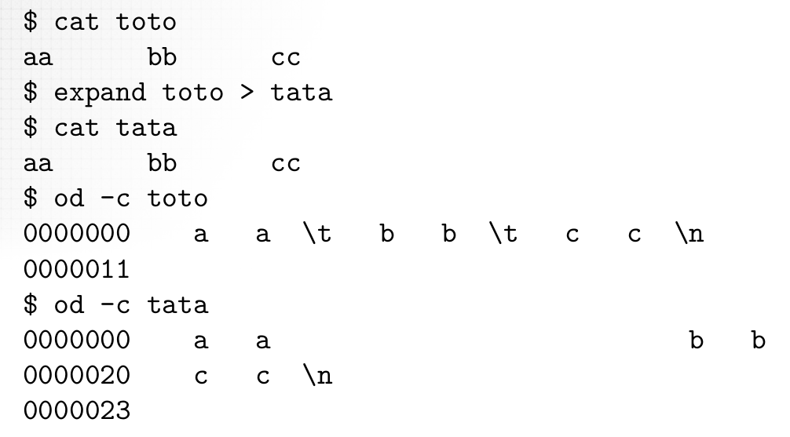
The command expand
Replace tabs with spaces in the arguments in text files with stops every 8 characters:

Slide 26
The command unexpand
Performs the inverse operation with the option -a :
$ unexpand -a tata > titi
$ od -c titi
0000000 a a \t b b \t c c \n 0000011
Without the option -a, unexpand only replace the 8 sequences of spaces in the beginning of the line.
http://en.wikipedia.org/wiki/Unexpand
LPIC-1 – Examen 101
<numéro> / 395

Slide 27
The command fmt
Rearranges paragraphs of text files arguments to obtain more than 75 lines characters:
$ cat toto
Here is a particularly poorly presented text file with a short line.
and with a line much much longer.
$ fmt toto
Here is a particularly poorly presented text file with a short line and with a line much much longer.
The option -w (width) specifies the desired maximum length:
$ fmt -w 50 toto
Here is a particularly poorly presented
text file with a short line and with a
line much much longer.
http://en.wikipedia.org/wiki/Fmt
LPIC-1 – Examen 101
<numéro> / 395

Slide 28
The command join
Carry out a join (like a DBMS) between the two files as arguments.
By default, the first field of each file is used for the join. Options -1 and -2 respectively indicate the field to be used in the first and the second file.
The fields are separated by default by blanks (spaces and tabs). The option -t specifies the character to use as a separator.
http://fr.wikipedia.org/wiki/Join_(Unix)
LPIC-1 – Examen 101
<numéro> / 395

Slide 29
The command join
$ cat authors
1
2
3
Tillier Claude
Hugo Dumas
Victor Alexandre
$ cat titles
1
2
2
3
3
My uncle Benjamin
Notre-Dame de Paris
Ruy Blas
Les Trois Mousquetaires (The Three Musketeers)
Le Comte de Monte-Cristo
$ join authors titles
Tillier Claude My uncle Benjamin
Hugo Victor Notre-Dame de Paris
Hugo Victor Ruy Blas
Dumas Alexandre Les Trois Mousquetaires
3 Dumas Alexandre Le Comte de Monte-Cristo
LPIC-1 – Examen 101
<numéro> / 395

Slide 30
The command paste
Concatenate the lines of the same number of files as arguments, separated by a tab.
The option -d indicates the character to use as a separator.
http://en.wikipedia.org/wiki/Paste_(Unix)
LPIC-1 – Examen 101
<numéro> / 395

Slide 31
The command paste
$ cat toto
toto1
toto2
toto3
$ cat tata
tata1
tata2
tata3
$ cat titi
titi1
titi2
titi3
$ paste toto tata titi
toto1 toto2 toto3
tata1 tata2 tata3
titi1 titi2 titi3
LPIC-1 – Examen 101
<numéro> / 395

Slide 32
The command sed
Means: stream editor.
Non-interactive text editor.
Often used to make replacements in files.
http://fr.wikipedia.org/wiki/Stream_Editor
LPIC-1 – Examen 101
<numéro> / 395

Slide 33
The command sed
Example:
$ cat topaze
Sheeps... sheeps... were safe…
in a park ; in a park.
Sheeps... sheepss...
Simple replacement:
$ sed s/sheep/rabbit/ topaz
Rabbits... sheeps... were safe…
in a park ; in a park.
Rabbits... sheepss...
Global replacement:
$ sed s/sheep/rabbit/ g topaz
Rabbits... rabbits... were safe…
in a park ; in a park.
Rabbits... rabbitss...
LPIC-1 – Examen 101
<numéro> / 395

Slide 34
The command sed
The option -i (in place) modifies the file directly:
$ sed -i s/sheep/rabbit/g topaz
LPIC-1 – Examen 101
<numéro> / 395

Slide 35
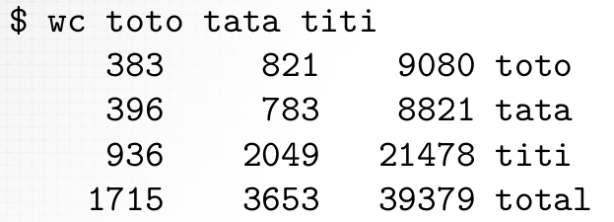
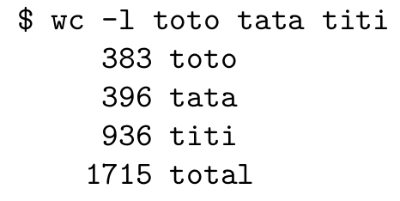
The command wc
Means: word count.
Count the number of lines, words and characters in file arguments:
The option -l only displays the number of lines:
http://en.wikipedia.org/wiki/Wc_(Unix)
LPIC-1 – Examen 101
<numéro> / 395

Slide 36
Summary
Subject 103 – GNU & Unix commands 113
Working from the command line 114
Text-stream processing with filters 141
Basic File Management 176
Using streams, pipes and redirects 226
Creation, control and interruption of process 244
Changing process priorities 264
Search in text files with regular expressions 268
Text file editing with vi 287
LPIC-1 – Examen 101
<numéro> / 395

Slide 37
The command ls
Principle
Means: list segments (name inherited from Multics).
Displays:
  the list of files in current directory (no argument):
$ ls
directory file
  or information about the files or directories as arguments:
$ ls -l file
-rw-r--r-- 1 owner groupr 1438102 Jan 2 14:34 file
Not to be confused with the command sl (install the sl package to see).
http://fr.wikipedia.org/wiki/Ls
LPIC-1 – Examen 101
<numéro> / 395

Slide 38
The command ls
Options
The option -l (long ) generates a long display:
$ ls -l total 1416
-rw-r--r-- 1 owner group 1438102 Jan
drwxr-xr-x 2 owner group 4096 Jan
2 14:34 file
2 15:02 directory
There is often an alias ll for ls -l.
The option -h (human readable) displays file sizes in a more readable form:
$ ls -lh total 1.4M
-rw-r--r-- 1 owner group 1.4M Jan 2 14:34 file
drwxr-xr-x 2 owner group 4.0K Jan 2 15:02 directory
LPIC-1 – Examen 101
<numéro> / 395

Slide 39
The command ls
Options
The option -a (all ) displays files whose name starts with a dot:
$ ls -a
. .. .bashrc file directory
The option -F adds a character as a result of certain file names to indicate their nature:
  / for directories
  * for executables
  @ for symbolic links
• ...
$ ls -F
file directory/
LPIC-1 – Examen 101
<numéro> / 395

Slide 40
The command ls
Options
The option -d (directory ) displays information about the directory itself rather than its content:
$ ls -l directory total 4
-rw-r--r-- 1 owner group 101 Jan 2 14:34 file_in_directory
$ ls -ld directory
drwxr-xr-x 2 owner group 4096 Jan 2 15:02 directory
LPIC-1 – Examen 101
<numéro> / 395

Slide 41
The command ls
Options
The option -R (recursive) recursively display the contents of all subdirectories:
$ ls -lR
.:
total 1416
-rw-r--r-- 1 owner group 1438102 Jan 2 14:34 file
drwxr-xr-x 2 owner group 4096 Jan 2 15:02 directory
./directory: total 4
-rw-r--r-- 1 owner group 101 Jan 2 14:34 file_in_directory
LPIC-1 – Examen 101
<numéro> / 395

Slide 42
The command touch
Principle
Fix dates last modified and last accessed arguments files to the current date:
$ ls -l toto
-rw-r--r-- 1 owner group 64 Dec 20 09:18 toto
$ date
tuesday 3 january 2012, 14:14:52 (UTC+0100)
$ touch toto
$ ls -l toto
-rw-r--r-- 1 owner group 64 Jan 3 14:14 toto
Incidentally, the files as arguments, which do not exist, are created empty. Moreover, we often use the command touch to create empty files.
http://fr.wikipedia.org/wiki/Touch_(Unix)
LPIC-1 – Examen 101
<numéro> / 395

Slide 43
The command touch
Options
The option -t allows to indicate the date to be assigned as [[SS]AA]MMJJhhmm[.ss] (parties in brackets are optional):
$ touch -t 02290000 toto
$ ls -l toto
-rw-r--r-- 1 owner group 64 Feb 29 00:00 toto
LPIC-1 – Examen 101
<numéro> / 395

Slide 44
The command mkdir
Means: make directories.
Create directories in arguments:
$ mkdir rep1 rep2 rep3
The option -p (parents) create intermediate directories if necessary:
$ mkdir rep1/rep2
mkdir: cannot create directory ‘rep1/rep2’: No such file or directory
$ mkdir -p rep1/rep2
http://fr.wikipedia.org/wiki/Mkdir
LPIC-1 – Examen 101
<numéro> / 395

Slide 45
The command rmdir
Means: remove directories.
Delete directories as arguments, provided that they are empty (that is to say containing only the directories . and ..):
$ rmdir rep1 rep2 rep3
Use rmdir on a non empty directory causes an error:
$ rmdir rep1
rmdir: failed to remove ‘rep1’: Directory not empty
http://en.wikipedia.org/wiki/Rmdir
LPIC-1 – Examen 101
<numéro> / 395

Slide 46
The command cd
Means: change directory.
Sets the current directory to the path argument:
$ cd chemin_d_acces
Without argument, the command cd brings back in the user's home directory:
$ cd
With argument -, the command cd brings back to the previous directory:
$ cd /path1
$ cd /path2
$ cd -
/path1
http://fr.wikipedia.org/wiki/Cd_(Commande)
LPIC-1 – Examen 101
<numéro> / 395

Slide 47
The command cp
Principle
Means: copy.
Used with two regular files arguments, the command cp copies the contents of the first file in the second:
$ cp toto tata
If the second file does not exist, it is created. If it already exists, it is overwritten.
Used with two or more arguments, the last of which is a directory and other ordinary files, the command cp copies the files with the same names in the directory:
$ cp toto tata rep
http://en.wikipedia.org/wiki/Cp_(Unix)
LPIC-1 – Examen 101
<numéro> / 395

Slide 48
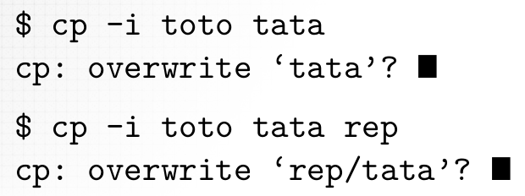
The command cp
Options
The option -i (interactive) requests confirmation before overwriting a file:
The option -R (recursive) performs recursive copies:
$ cp -R rep1 rep2 rep3
By default, the copied files were last modified date as that of the execution of cp. The -p (preserve) assigned to each copy of the last modified date of the original file.
LPIC-1 – Examen 101
<numéro> / 395

Slide 49
The command mv
Principle
Means: move.
Used with two arguments:
  if the first argument is a regular file and the second argument is either a regular file (which will be overwritten) or non-existent, the command mv renames (and possibly moved) the first by assigning the name of the second:
$ mv toto tata
$ mv toto rep/tata
  if the first argument is a directory, and the second argument is non-existent, the command mv renames (and possibly moved) the first by assigning the name of the second:
$ mv rep1 rep2
$ mv rep1 rep2/rep3
http://en.wikipedia.org/wiki/Mv
LPIC-1 – Examen 101
<numéro> / 395

Slide 50
The command mv
Principle
Used with two or more arguments, the last of which is a directory that exists, the command mv moves files or directories specified by first arguments with the same names in the directory last argument:
$ mv toto tata rep1 rep2
LPIC-1 – Examen 101
<numéro> / 395

Slide 51
The command mv
Options
The option -i (interactive) requests confirmation before overwriting a file:
$ mv -i toto tata
mv: overwrite ‘tata’? □
$ mv -i toto tata rep
mv: overwrite ‘rep/tata’? □
LPIC-1 – Examen 101
<numéro> / 395

Slide 52
The command rm
Removes regular files as arguments:
$ rm toto tata titi
The option -r (recursive) only remove the directories and all their contents:
$ rm -r toto rep
The option -i (interactive) requests confirmation before each deletion:
$ rm -i toto
rm: remove regular file ‘toto’? □
http://fr.wikipedia.org/wiki/Rm_(Unix)
LPIC-1 – Examen 101
<numéro> / 395

Slide 53
The command file
Attempts to determine the type of the file argument by examining its contents, particularly its first bytes that constitute its "magic number":
$ file /etc/passwd
/etc/passwd: ASCII text
$ file /bin/ls
/bin/ls: ELF 32-bit LSB executable, Intel 80386, [...]
http://fr.wikipedia.org/wiki/File_(Unix) http://fr.wikipedia.org/wiki/Nombre_magique_(programmation)
LPIC-1 – Examen 101
<numéro> / 395

Slide 54
Files name generation wildcards
Principle
Wildcards are used to designate compactly a file name together with the common parts.
The management of meta characters is performed by the shell before executing the command.
English words: joker, wildcard, file globbing.
http://fr.wikipedia.org/wiki/Métacaractère
LPIC-1 – Examen 101
<numéro> / 395

Slide 55
Files name generation wildcards
?
Wildcard ? matches exactly any character:
$ ls
glub toto1 toto2 toto3 tutu
$ echo toto?
toto1 toto2 toto3
LPIC-1 – Examen 101
<numéro> / 395

Slide 56
Files name generation wildcards
[ . . . ]
More accurate than ?, a bracket expression matches exactly one character from those indicated. It mays contain:
  a sequence of characters:
$ ls
toto1 toto2 toto3 toto4 toto5 toto6 toto7 toto8
$ echo toto[135]
toto1 toto3 toto5
  a range of characters (similar):
$ echo toto[3-6]
toto3 toto4 toto5 toto6
LPIC-1 – Examen 101
<numéro> / 395

Slide 57
Files name generation wildcards
if the expression begins by ! or ^, its meaning is reversed (the characters are not part of the remainder of the term which are taken into account):
$ echo toto[!3-6]
toto1 toto2 toto7 toto8
[ . . . ]
LPIC-1 – Examen 101
<numéro> / 395

Slide 58
Files name generation wildcards
*
The meta wildcard * matches zero or more of any character:
$ ls
glop glub tata titi toto tutu
$ echo *
glop glub tata titi toto tutu
LPIC-1 – Examen 101
<numéro> / 395

Slide 59
Files name generation wildcards
The files whose names begin with .
The files whose names begin with . are never taken into account when the generation of files names.
So:
$ rm *
does not delete files whose names begin with . and must be explicitly:
$ rm .??*
The option dotglob of bash allows to take into account the files whose name starts with . (except . and ..) :
$ shopt -s dotglob
LPIC-1 – Examen 101
<numéro> / 395

Slide 60
Files name generation wildcards
Inhibition of wildcards
Un nom de fichier peut tout à fait contenir un symbole également utilisé comme métacaractère, par exemple toto* ou [1].
A file name may well contain a symbol also used as a wild card, eg toto* or [1].
These file names are perfectly valid but their use in the command needed to take precautions, was preceded in each symbol by a backslash or surrounding filenames by a pair of quotation marks or apostrophes.
For example, to delete, you can do:
$ rm toto\* \[1\]
$ rm "toto*" "[1]"
$ rm ’toto*’ ’[1]’
LPIC-1 – Examen 101
<numéro> / 395

Slide 61
Files name generation wildcards
Error management
By default, an expression containing a wildcard will match any filename is left unchanged:
$ ls
toto1 toto2 toto3
$ echo toto? apasfichier* toto1 toto2 toto3 apasfichier*
NB:
Pas = not
Fichier = file
LPIC-1 – Examen 101
<numéro> / 395

Slide 62
Files name generation wildcards
Error management
The option nullglob of bash makes sure to ignore such expressions:
$ shopt nullglob nullglob off
$ shopt -s nullglob
$ shopt nullglob nullglob on
$ echo toto? apasfichier* toto1 toto2 toto3
LPIC-1 – Examen 101
<numéro> / 395

Slide 63
Files name generation wildcards
Error management
The option failglob of bash will display an error message in this case and the order is not executed:
$ shopt failglob failglob off
$ shopt -s failglob
$ shopt failglob failglob on
$ echo toto? apasfichier* bash: no match: apasfichier*
LPIC-1 – Examen 101
<numéro> / 395

Slide 64
The command find
Principle
Search files by various criteria by browsing the file system from the specified directory argument, or, if it is not specified, the current directory:
$ find rep -name toto
To be avoided (especially when using file servers):
$ find / -name toto
http://fr.wikipedia.org/wiki/Find
LPIC-1 – Examen 101
<numéro> / 395

Slide 65
The command find
Criteria -name
Finding files by name:
$ find . -name toto
The command find can manage the wildcards but they must be escaped to avoid being captured by the shell:
$ find . -name \*.txt
LPIC-1 – Examen 101
<numéro> / 395

Slide 66
The command find
Criteria -type
Finding files by type:
$ find . -type f
Possible types:
b block special files
c character special files
d directories
f ordinary files
l symlinks
p named pipe
s sockets
LPIC-1 – Examen 101
<numéro> / 395

Slide 67
The command find
Criteria -size
Finding files by size:
  files larger than 10 KB:
$ find . -size +10k
  files less than 10 Ki:
$ find . -size -10k
The usable units are:
c: bytes
k: kilobytes
M: Megabytes
G: Gigabytes
LPIC-1 – Examen 101
<numéro> / 395

Slide 68
The command find
Temporal criteria
The command find recognizes the following time criteria:
-amin
-atime
-cmin
-ctime
-mmin
-mtime
last accessed in minutes
last accessed in days
last change of metadata in minutes
latest update metadata days
last modified in minutes
last change in days
LPIC-1 – Examen 101
<numéro> / 395

Slide 69
The command find
Combine multiple criteria
Several criteria used together are connected by an "and" implicit:
$ find . -name \*.txt -type f -size +10k
-o combines two criteria with « or » :
$ find . -name \*.txt -o -size +10k
-a combine two criteria with « and » :
$ find . -name \*.txt -a -size +10k
A criterion can be reversed by preceding it with ! (Which must be escaped, that character with special meaning to the shell):
$ find . \! -name \*.txt
LPIC-1 – Examen 101
<numéro> / 395

Slide 70
The command find
Combine multiple criteria
Parentheses (which must be occupied for the same reason) allow to group multiple criteria and to force the priority level:
$ find . \( -name \*.png -a -size +10k \) \
-o \( -name \*.jpg -a -size +10k \)
LPIC-1 – Examen 101
<numéro> / 395

Slide 71
The command gzip
Compresses a file with a compression algorithm without loss to give a file of the same name with a .gz extension (the original file is deleted):
$ ls -l total 62
-rw-r--r-- 1 owner group 651961 Feb 28 14:58 toto
$ gzip toto
$ ls -l total 14
-rw-r--r-- 1 owner group 176129 Feb 28 14:58 toto.gz
http://www.gnu.org/software/gzip/ http://fr.wikipedia.org/wiki/Gzip
LPIC-1 – Examen 101
<numéro> / 395

Slide 72
The command gzip
The options -1 to -9 allow to set the compression level (-1 is the least effective, -9 is the most effective, -6 is the level used by default):
$ gzip -9 toto
$ ls -l total 14
-rw-r--r-- 1 owner group 175568 Feb 28 14:58 toto.gz
LPIC-1 – Examen 101
<numéro> / 395

Slide 73
The command gunzip
Decompress a file compressed with gzip (the compressed file is deleted) :
$ ls -l total 14
-rw-r--r-- 1 owner group 176129 Feb 28 14:58 toto.gz
$ gunzip toto.gz
$ ls -l total 62
-rw-r--r-- 1 owner group 651961 Feb 28 14:58 toto
LPIC-1 – Examen 101
<numéro> / 395

Slide 74
The command bzip2
Compresses a file with a compression algorithm without loss (usually more efficient than gzip) to give a file of the same name with a .bz2 extension (the original file is deleted):
$ ls -l total 62
-rw-r--r-- 1 owner group 651961 Feb 28 14:58 toto
$ bzip2 toto
$ ls -l total 12
-rw-r--r-- 1 owner group 138720 Feb 28 14:58 toto.bz2
There are also options -1 to -9 for setting the compression level (-9 is the level used by default).
http://www.bzip.org/ http://fr.wikipedia.org/wiki/Bzip2
LPIC-1 – Examen 101
<numéro> / 395

Slide 75
The command bunzip2
Decompress a bzip2 compressed file (the compressed file is deleted):
$ ls -l total 12
-rw-r--r-- 1 owner group 138720 Feb 28 14:58 toto.bz2
$ bunzip2 toto.bz2
$ ls -l total 62
-rw-r--r-- 1 owner group 651961 Feb 28 14:58 toto
LPIC-1 – Examen 101
<numéro> / 395

Slide 76
The command xz
Compresses a file with a compression algorithm without loss to give a file of the same name with an extension .xz (the original file is deleted):
$ ls -l total 62
-rw-r--r-- 1 owner group 651961 Feb 28 14:58 toto
$ xz toto
$ ls -l total 14
-rw-r--r-- 1 owner group 142868 Feb 28 14:58 toto.xz
http://tukaani.org/xz/ http://fr.wikipedia.org/wiki/XZ_(format_de_fichier)
LPIC-1 – Examen 101
<numéro> / 395

Slide 77
The command xz
Options -0 to -9 options allow for setting the compression level (-0 is the least effective, -9 is the most effective, -6 is the level used by default):
$ xz -9 toto
$ ls -l total 14
-rw-r--r-- 1 owner group 142868 Feb 28 14:58 toto.xz
LPIC-1 – Examen 101
<numéro> / 395

Slide 78
The command unxz
Decompress a compressed file with xz (the compressed file is deleted):
$ ls -l total 14
-rw-r--r-- 1 owner group 142868 Feb 28 14:58 toto.xz
$ unxz toto.xz
$ ls -l total 62
-rw-r--r-- 1 owner group 651961 Feb 28 14:58 toto
LPIC-1 – Examen 101
<numéro> / 395

Slide 79
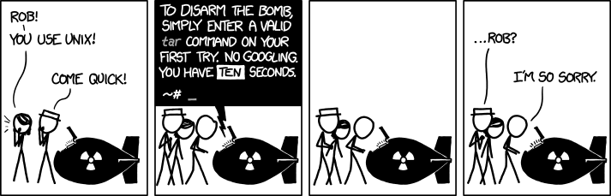
The command tar
Principle
Means : tape archiver.
http://fr.wikipedia.org/wiki/Tar_(informatique) http://xkcd.com/1168/
LPIC-1 – Examen 101
<numéro> / 395

Slide 80
The command tar
Options
The options command tar don't need to be introduced by a dash.
Options specifying the operation to perform (it is mandatory and exactly one and it must appear first):
c create an archive
x extract an archive
t list the content of an archive
Other useful options:
f file (ordinary or special) to use
j compression or decompression with bzip2
J compression or décompression with xz
v wordy display
z compression or décompression with gzip
LPIC-1 – Examen 101
<numéro> / 395

Slide 81
The command tar
Examples
Creating an archive:
$ tar cvf archive.tar file ...
# tar cvf /dev/nst0 file ...
Extracting an archive:
$ tar xvf archive.tar
# tar xvf /dev/nst0
Extracting some files from an archive:
$ tar xvf archive.tar path1 path2
Listing an archive:
$ tar tf archive.tar
# tar tf /dev/nst0
LPIC-1 – Examen 101
<numéro> / 395

Slide 82
The command cpio
Principle
Means : copy (archive files) in and out.
Use by default standard input and standard output.
The most useful options:
-o | create an archive
-a | restore the last access of files read
-i | extract an archive
-d | create intermediate directories
-m | restore the last modification date
-t | list the contents of an archive
-B | treatment in blocks of 5120 bytes
-v | wordy display
http://en.wikipedia.org/wiki/Cpio
LPIC-1 – Examen 101
<numéro> / 395

Slide 83
The command cpio
Examples
Creating an archive:
$ find directory | cpio -oav > archive.cpio
# find directory | cpio -oaBv > /dev/nst0
Extracting an archive:
$ cpio -idmv < archive.cpio
# cpio -idmBv < /dev/nst0
Listing an archive:
$ cpio -itv < archive.cpio
# cpio -itBv < /dev/nst0
LPIC-1 – Examen 101
<numéro> / 395

Slide 84
The command dd
Principle
Means: convert and copy (but the cc command is already used to invoke the C compiler, where dd offset by a letter, as HAL and IBM).
Synopsis :
$ dd [operand=value ...]
Operands most useful:
bs (block size) | number of bytes per block
count | number of bytes to copy
if (input file) | input file
of (output file) | output file
http://fr.wikipedia.org/wiki/Dd_(Unix)
LPIC-1 – Examen 101
<numéro> / 395

Slide 85
The command dd
Examples
Create a swap file:
# dd if=/dev/zero of=swapfile bs=1024 count=65536
Make an image of a CD-ROM:
# dd if=/dev/sr0 of=image.iso bs=2352
Make an image of a DVD-ROM:
# dd if=/dev/sr0 of=image.iso bs=2418
Make an image of a partition of a hard drive:
# dd if=/dev/sda1 of=sda1.img bs=512
Write a partition of a hard drive from an image:
# dd if=sda1.img of=/dev/sda1 bs=512
LPIC-1 – Examen 101
<numéro> / 395

